Slide 1
PetAid Harness
Department of Electrical and Computer Engineering
University of Central Florida
Dr. Richie
Group 8
Pascal Bahms – EE
Pedro Rocha – EE
Edgar Gonzalez – EE
Adam Henderson – CpE

Slide 2
Project Plan
Shipping
Prototype
Gather and receive all materials
Prototype Implementation and Testing
Team
Testing
Finalize
Brainstorm and Project Plan
Hardware Testing
Final Documentation and Product

Slide 3
Project Description
Dog Harness
Harness mounted with smart electronic device
Biometric and location tracking device

Slide 4
Project Motivation
Survey conducted by the American Pet Products Association (APPA), a total of about 67% of U.S. households
Will help if the pet is having a medical emergency while the owner is not present
Preventative medicine
the average American household will spend $426 on surgical vet visits and $212 on routine vet checkups annually, totaling $642 of yearly vet fees
Decrease the cost of pet care stuff

Slide 5
Dog Harness vs. Collar
Harness gives more surface area for devices to be placed
Harness has a more stable position on the dog than a collar
Collar is far more lightweight and easier to put on the dog
Collar could be more familiar and comfortable for dogs

Slide 6
Project Goals & Objectives
To create a harness for one's pet that can monitor their physical condition and location, making it easier for the owner to ensure their pet's well-being To create a fully functioning PetAid harness To create a phone application that can register, operate, and manage PetAid harnesses

Slide 7
Typical Dog Harness
RabbitGoo Adjustable Oxford No Pull Dog Harness
Space for electronics

Slide 8
Standards
Alkaline Power Supply Standards
IEEE.org (Standard 1625)
Batterypoweronline.com (ANSI standard C18.2M)
Bluetooth Standards
IEEE 802.15.1

Slide 9
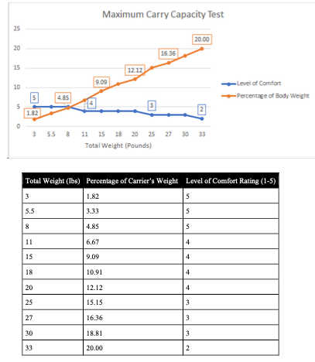
Standards
Development of new pet care standards
Standard PAH-1.1: On carrying capacity of house pets
Standard PAH-1.2: On temperature sensitivity of house pets

Slide 10
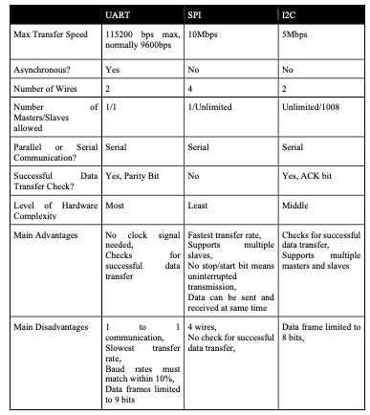
Standards
Microcontroller data communication standards
UART
SPI
I2C

Slide 11
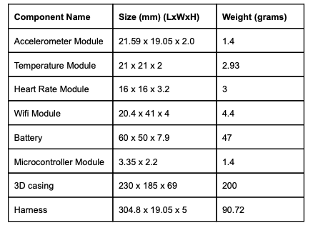
Specifications and Requirements
Overall Weight
Minimum dog weight
Operating Temperature
Wifi integrated
Battery time

Slide 12
Specifications and Requirements
3 data values monitored
Response time
Notification prerequisites

Slide 13
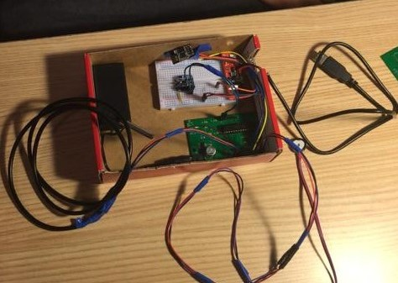
Electronic Device Enclosure

Slide 14
DESIGN FLOWCHART
Wireless Communication (wifi)
Printable Circuit Board (PCB)
Pulse Sensor
ThingSpeak (IOT)
Temperature Sensor
USER
PET
Accelerometer
Power Supply

Slide 15
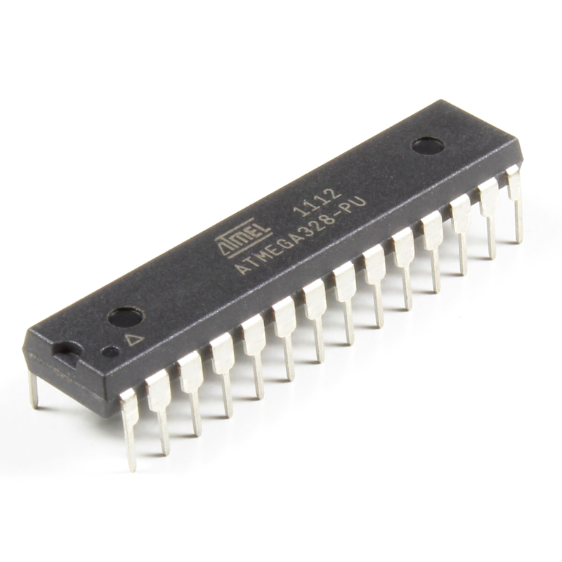
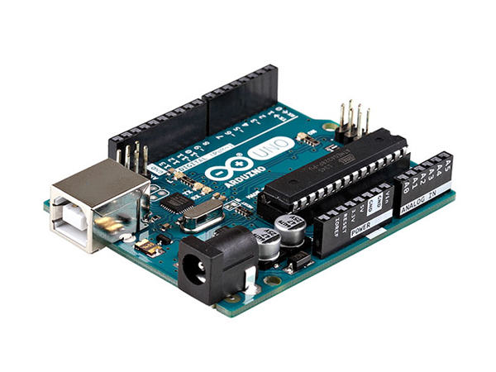
MICROCONTROLLER: ATmega328P-PU
Arduino UNO uses the ATmega328P-PU chip
32KB of in-system self-programmable flash program memory
Simplified version of C++
Operating Voltage: 2.7V - 5.5V
At 5V it draws about 1mA, for 5mW of power
Cost: $22.00

Slide 16
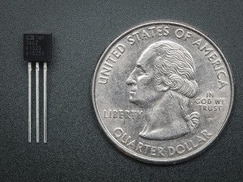
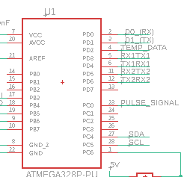
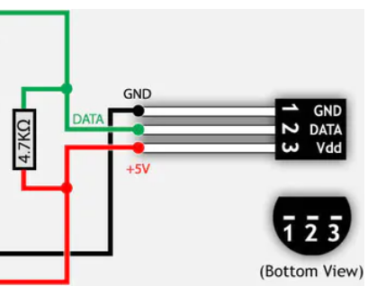
TEMPERATURE SENSOR: DS18B20
Arduino UNO compatible
Accuracy: +/- 2 ºC (at 25 ºC)
Communication protocol: One-wire
Operating Voltage: 3V – 5.5V DC
Current consumption 1.5 mA
Cost: $3.95
Available in waterproof version
Cost: $9.95

Slide 17
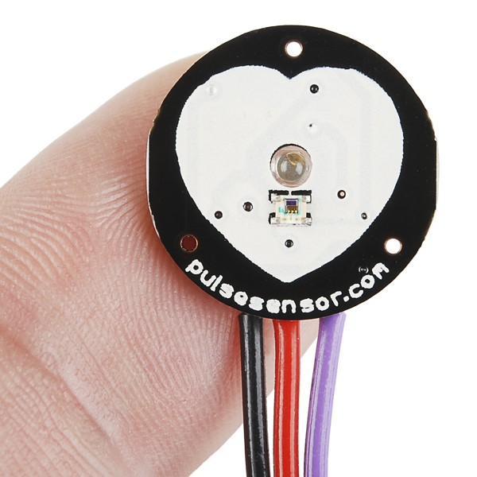
PULSE SENSOR: SEN-11574
Arduino UNO compatible
Operating Voltage: 3V – 5.5V DC
Current Consumption: 4mA at 5V
Fairly accurate
Cost: $4.36

Slide 18
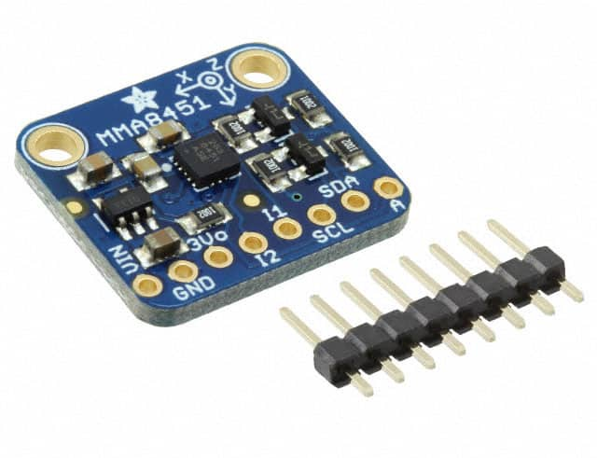
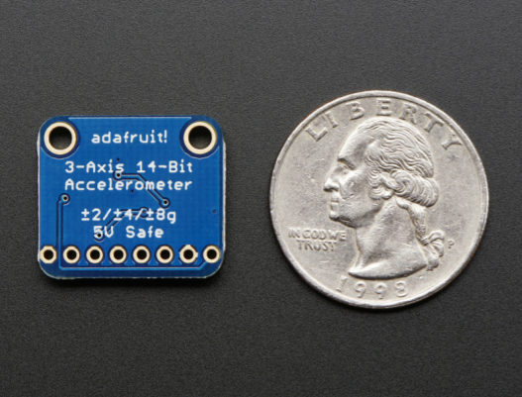
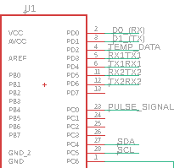
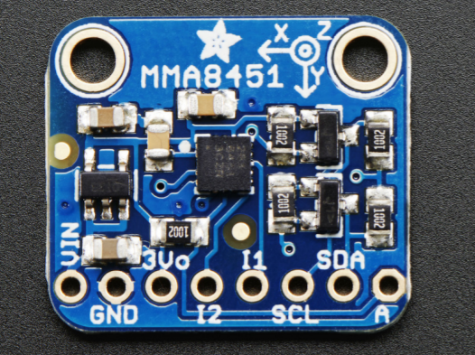
ACCELEROMETER: MMA8451
Detect Motion, Tilt, and Basic Orientation
Low Cost, High Precision 14-bit ADC
Wide Usage Range: +2g, +4g, +8g
Low-dropout 3.3V regulator and level shifting circuitry on board.
I2C Serial Communication Interface
Operating Voltage: 3.3V-5VDC
Cost: $7.95

Slide 19
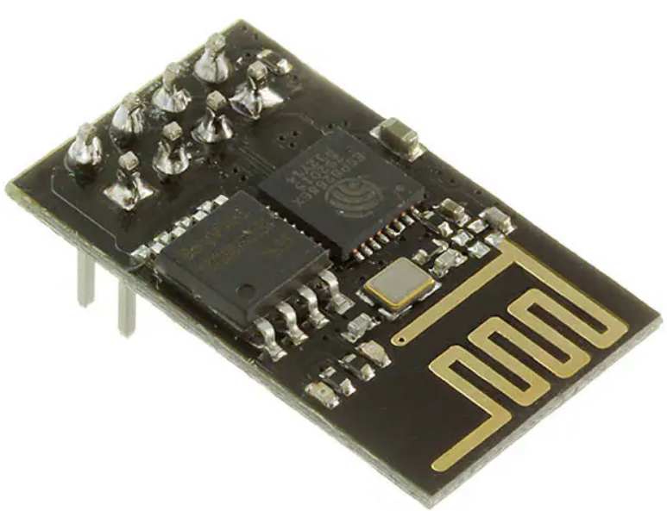
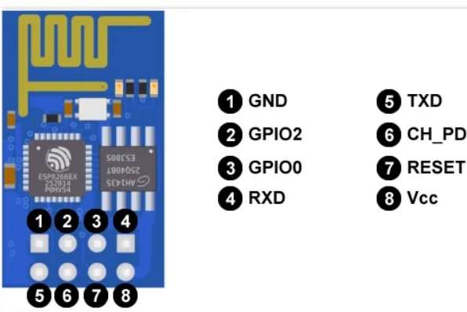
Wifi: ESP8266-01
Can be programmed using the Arduino IDE programming environment
Operating voltage: 3.3 V DC
Operating current: 240 mA at 3.3V
Wifi connecting range: 5 meters
Simplified version of C++
Cost: $6.95

Slide 20
POWER SUPPLY: 9-Volt
Component | Current draw | Input Voltage
ATmega328P-PU | 1 mA | 5 V DC (recommended)
DS18B20 Temperature sensor | 1.5 mA | 3.3 V - 5.5 V DC
SEN 11574 Heart-Rate sensor | 4 mA | 3 V - 5.5 V DC
MMA8451 Accelerometer module | 11 mA | 2.7 V - 5.5 V DC
ESP8266 Wifi module | 240 mA | 3.3 V DC
Result | The total current drawn is 258 mA | Nominal voltage at 3.3 V for sensors and 5 V for ATmega328P-PU
Powered the PCB using the 9 V Alkaline battery
500mAh
Cost: $1.98
Current consumption equation
hour = Total Capacity (mAh)/Current draw
(mA)
hour = 500 mAh/258 mA = 2h
Wifi separate power supply
Hour = 500 mAh/17.5 mA = 29h

Slide 21
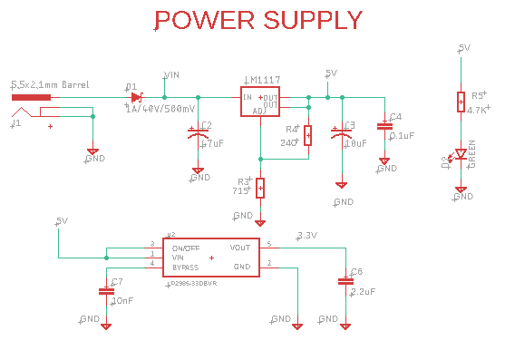
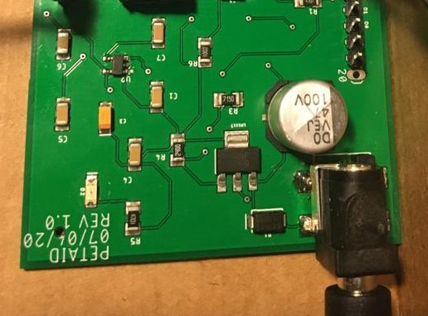
DC barrel power jack/connector
Compatible with a DC wall supply 5.5 mm jack, with a 2.1 mm center pole Diameter
Schottky Diode (MBRA140)
5 Voltage regulator (LM117)
3.3 V regulator (LP2985)
Decoupling capacitors
Green LED

Slide 22
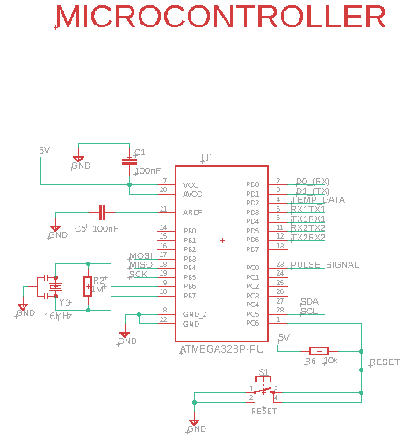
5V input voltage and ADC converter input
16 MHz ceramic resonator clock
Digital peripheral input pins
Analog peripheral input pins
Push reset button for debugging
Notes:
Here, we are looking at the ATMEGA328P-PU microcontroller, and starting from the upper left side of the board we see the 5V input voltage connected to the ADC Converter, as well as a decoupling capacitor to the ground to reduce noise. Moving down, we have another decoupling capacitor for the analog reference which is also grounded, and under that we have our 16 MHz ceramic resonator, and our ground pins. On the right, we have our digital and analog pins that we used for the peripheral data input, and the push button to reset during debugging.

Slide 23
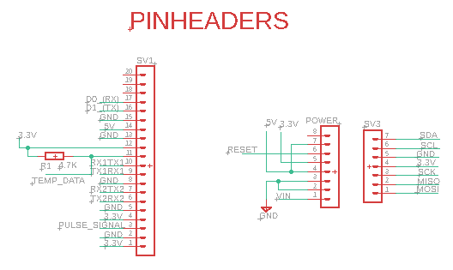
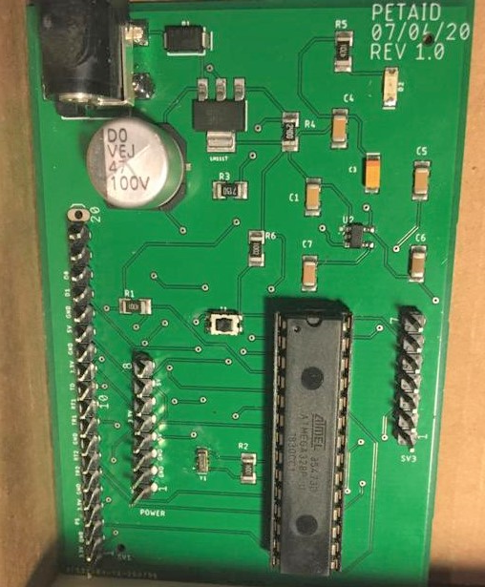

Slide 24
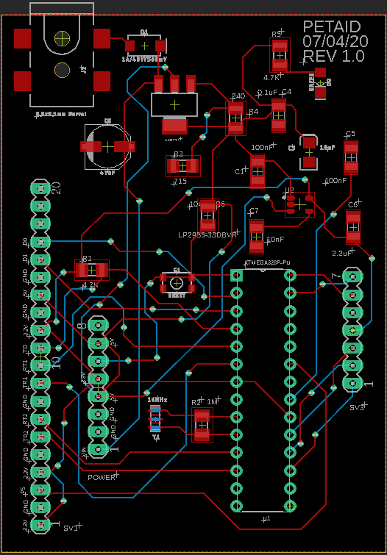
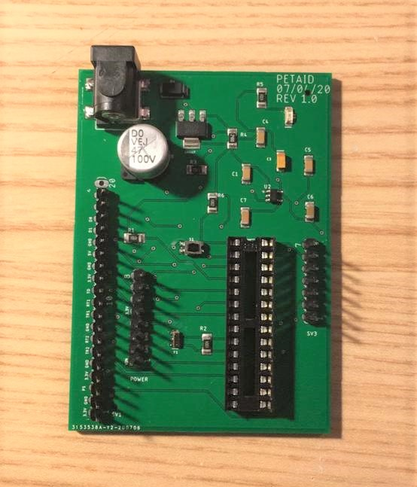
PCB Layout

Slide 25
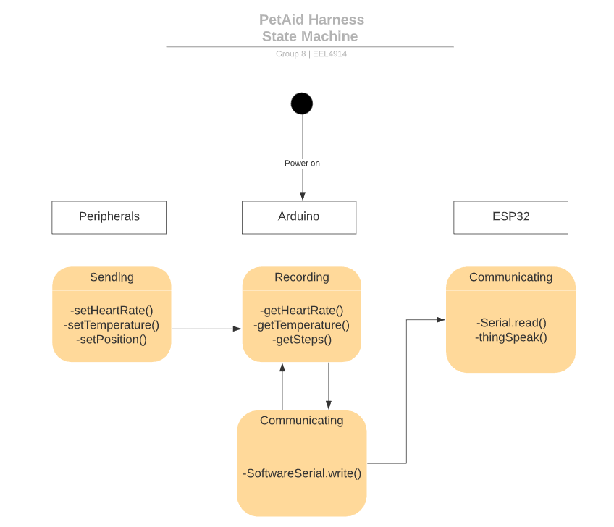
State Diagram

Slide 26
INTERNET OF THINGS
ThingSpeak
Free accounts offer limits on certain functionality
Limited to sending no more than 3 million messages each year to ThingSpeak service
Limited to 4 channels
15 second interval update
Easy access to data from sensors
Accurately displays data
Keep track of previous Data
Displays trend on chart

Slide 27
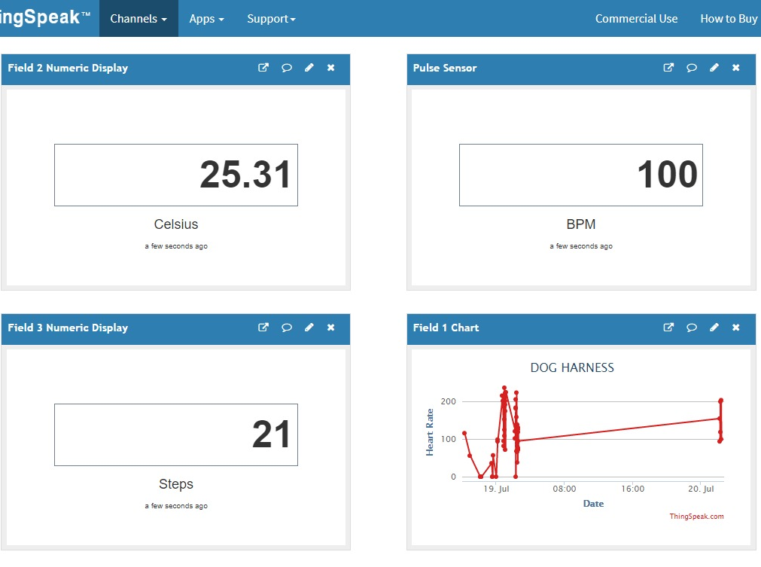
ThingSpeak

Slide 28
Administrative Tasks
Pedro | Edgar | Adam | Pascal
Test & Code Hardware Sensors | Test & Code Hardware Sensors | Wireless Communication | Harness/Housing
Equipment/ Instrumentation | Power Supply | Requirements/ Specifications | Design Layout
PCB Schematic (Secondary) | PCB Schematic (Primary) | IoT | Standards
PCB Layout (Primary) | PCB Board (Secondary)

Slide 29
Budget & Finance Cost
Components | Website | Quantity | Price | Per Unit Cost
DS18B20+ and Waterproof type | https://www.digikey.com/product-detail/en/maxim-integrated/DS18B20-/DS18B20--ND/956983 | 1+1 | $4.36 + $6.97 | $4.36
SEN-11574 | https://www.digikey.com/product-detail/en/sparkfun-electronics/SEN-11574/1568-1247-ND/5762397 | 2 | $24.95 each | $24.95
MMA8451 | https://www.digikey.com/product-detail/en/adafruit-industries-llc/2019/1528-1041-ND/4990790 | 2 | $7.95 each | $7.95
WIFI Module ESP8266 | https://www.sparkfun.com/products/13678 | 2 | $6.95 each | $6.95
WIFI Module ESP32WROOM | https://www.digikey.com/product-detail/en/espressif-systems/ESP32-DEVKITC-32D/1965-1000-ND/9356990 | 1 | $10.00 | $10.00
Logic-Level Converter | https://www.digikey.com/product-detail/en/sparkfun-electronics/BOB-12009/1568-1209-ND/5673795 | 1 | $2.95 | $2.95
Battery 3.7V 1.2AH | https://www.digikey.com/product-detail/en/adafruit-industries-llc/258/1528-1838-ND/5054544 | 1 | $9.95 | $9.95
GSMMQB-UFL 850MHz/900MHz | https://www.digikey.com/product-detail/en/rf-solutions/ANT-GSMMQB-UFL/ANT-GSMMQB-UFL-ND/2781747 | 1 | $6.17 | $6.17
ECHO/5.0 GPS Antenna | https://www.digikey.com/product-detail/en/siretta-ltd/ECHO5-0.1M-UFL-S-S-15/ECHO5-0.1M-UFL-S-S-15-ND/6096346 | 1 | $14.48 | $14.48
Arduino UNO R3 ATMEGA328P | https://www.digikey.com/product-detail/en/arduino/A000066/1050-1024-ND/2784006 | 2 | $22.00 each | $22.00
SIM808 GPS+GSM | https://www.itead.cc/sim808-gsm-gprs-gps-module.html | 1 | $40.00 | $40.00
Breadboard Power Supply Stick 5V/3.3V | https://www.sparkfun.com/products/13032 | 2 | $11.95 each | $11.95
PCB (5+2 SMT Assembly) | https://jlcpcb.com/ | 5+2( SMT Assembly) | $48.54 | $23.00
Other |  |  | $38.60
Total |  |  | $329.62 | $184.71

Slide 31
Project Difficulties
^{Difficulty meeting}
Getting the accelerometer to work as a step counter
^{Implementing all three sensors}
^{Power supply}
Wireless Communication Difficulty

Slide 32
Project Successes
Individual Prototype testing
Implementation of DS18B20+, SEN-11574, Accelerometer
Wireless Communication to the cloud
IOT ThingSpeak analyze data
Receive completed PCB
Gather and Receive all materials
Hardware Test
Brainstorm & Project Plan
Prototype Implementation

